Slide 1
Sisteme Tolerante la Defecte Servicii - REST
Lect. Dr. Ing. Cristian Chilipirea – cristian.chilipirea@mta.ro

Slide 3
Implementări servicii
SOAP – Simple Object Access Protocol
RabbitMQ, ActiveMQ, JMS
gRPC – google Remote Procedure Call
WCF – Windows Communication Foundation
REST

Slide 4
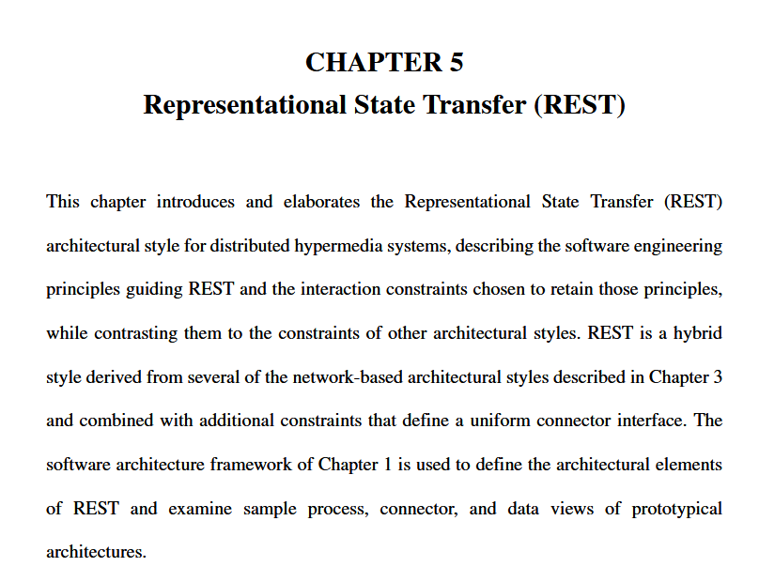
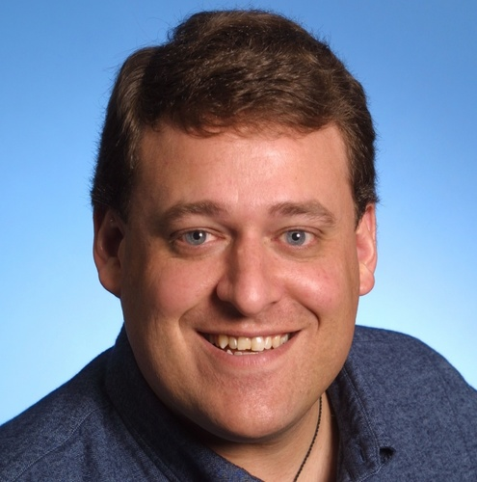
REpresentational State Transfer (REST)
Roy Fielding

Slide 5
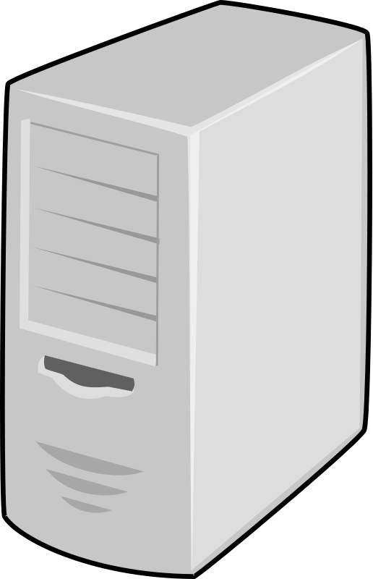
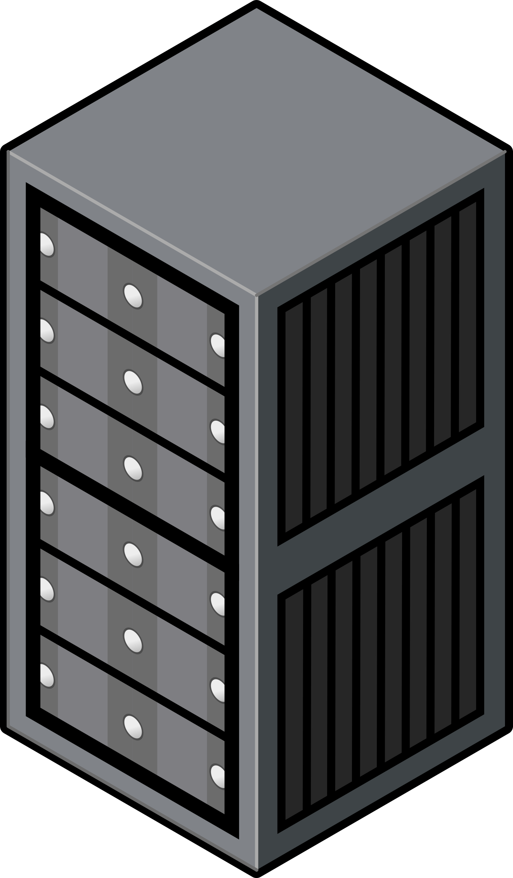
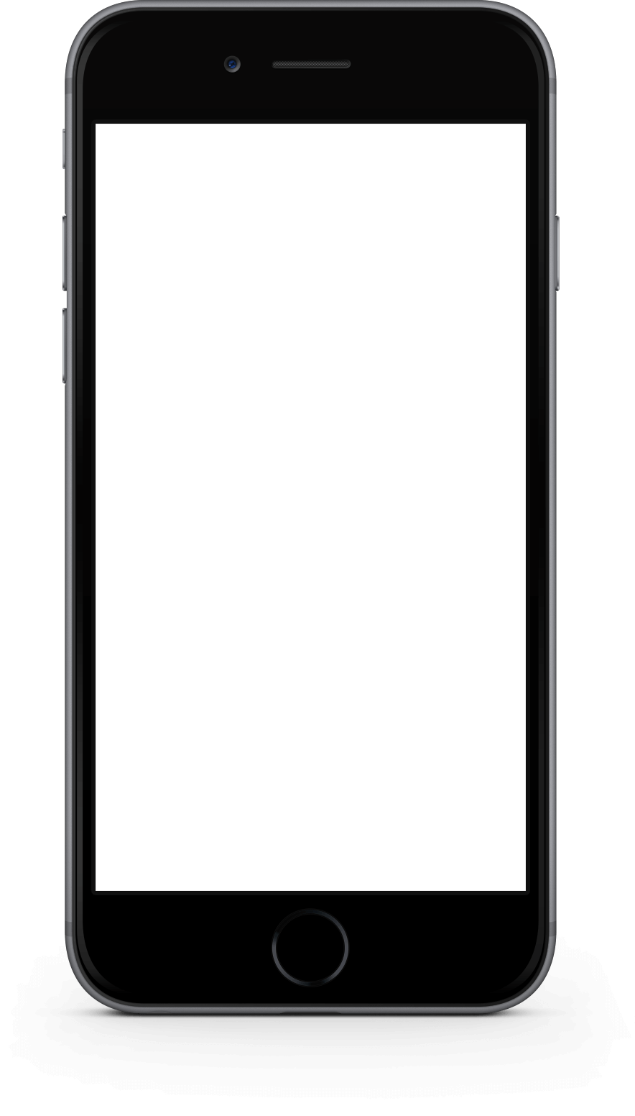

REST – Client-Server
Request
Reply

Slide 6
REST - Stateless
Visibility
Reliability
Scalability
Request (+state info)
Reply
Fără informații de context pe server

Slide 7
REST - Cache
Request (+state info)
Request (+state info)
Reply
Reply
Cache
Poate fi server
Poate fi local client
Request (+state info)
Reply

Slide 8
REST – Uniform Interface
Identification of resources
Manipulation of resources
Self-descriptive messages

Slide 9
REST – layered system
Independence
Permits load balancing
Request (+state info)
Request (+state info)
Reply
Reply

Slide 10
Microservicii
=
Containere + Servicii

Slide 11
Microservicii exemplu
Site PIZZA
Listare produse
Autentificare/Autorizare
Coș
Comenzi

Slide 12
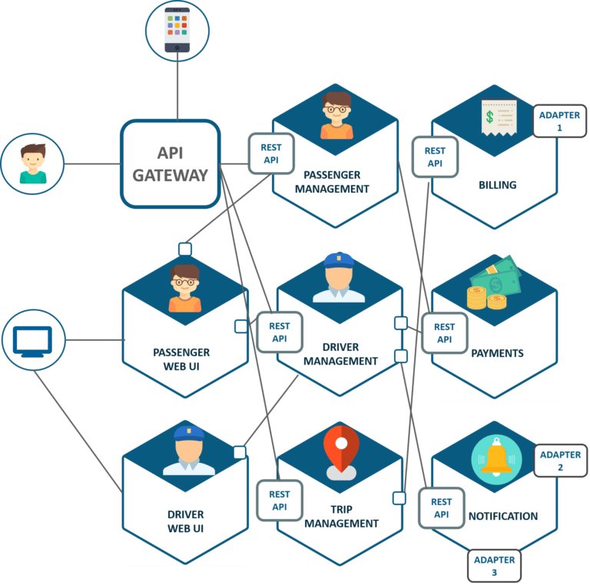
Uber
Notes:
https://dzone.com/articles/microservice-architecture-learn-build-and-deploy-a

Slide 13
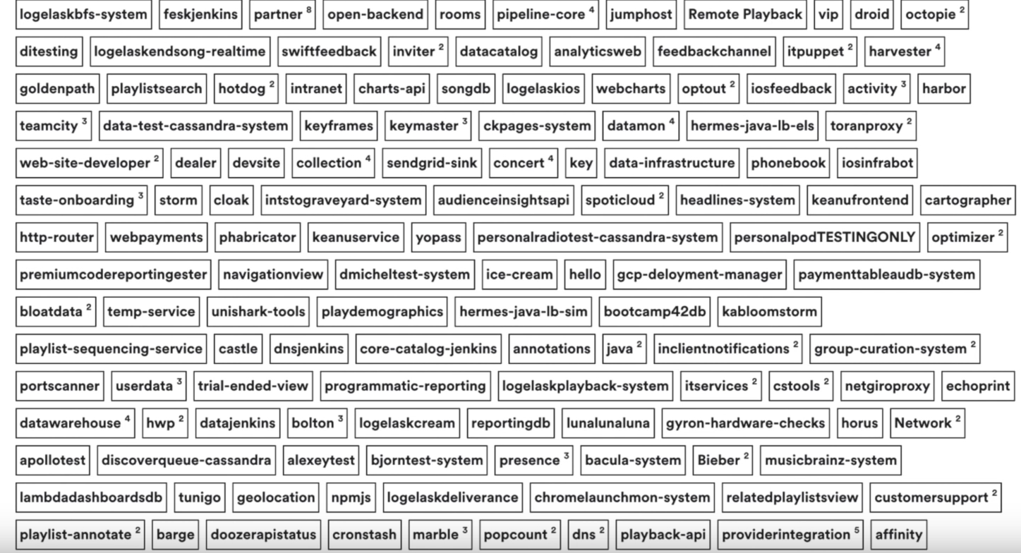
Spotify

Slide 14
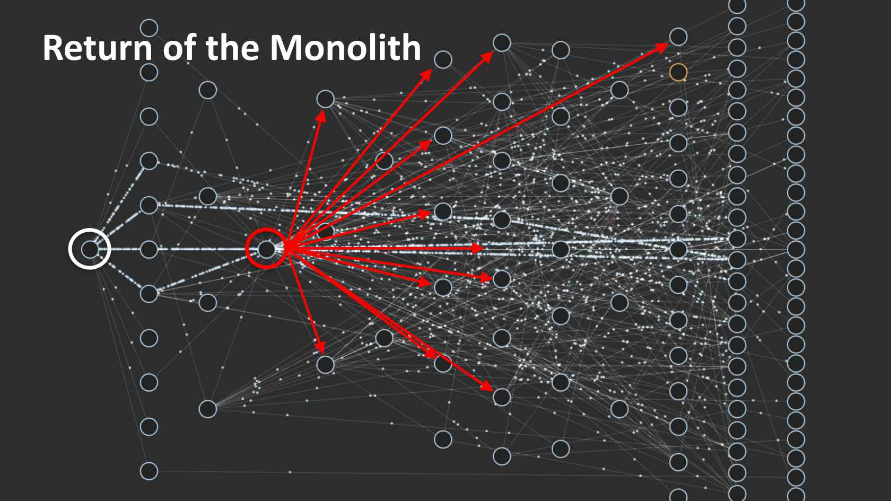
Netflix - 2016

Slide 15
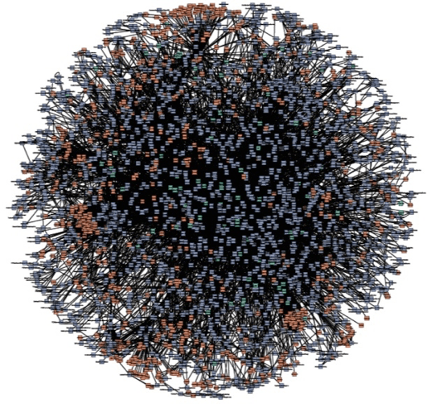
Amazon

